Slide 1
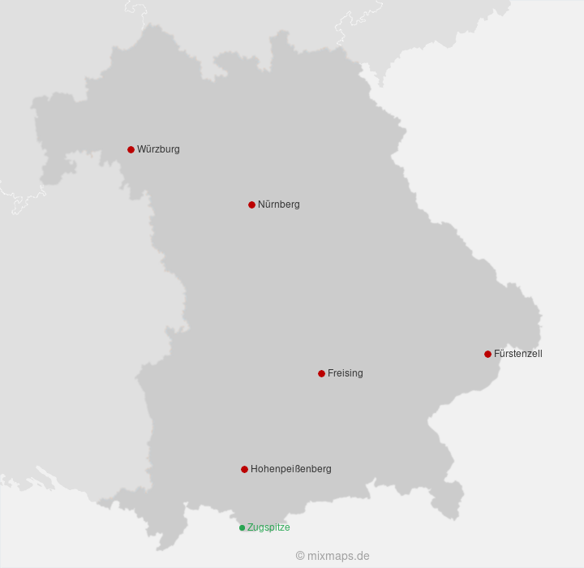
Production of Solar Energy in Bavaria
Data Science Project Team :
1- Ullrich Seidel
2- Ramin Sadrpanah
3- Mohammad Hussain Rajai

Slide 2
Hypothesis
A short-term prediction of daily produced solar energy based on weather data (sun) and the up-to-date production capacity
A long-term forecast of the year 2024 based on actual produced solar energy in the years of 2015 – 2023

Slide 3
Data Gathering
Daily data from 01.01.2015 to 31.12.2023 from public sources was used
Production Data: TenneT (Transmission System Operator)
Solar Panels Capacity: Marktstammdatenregister (by Bundesnetzagentur)
Weather Data: 6 Stations in Bavaria (from Deutscher Wetterdienst(DWD))
Data had partially to be downloaded manually before and to be extracted via script, and merged afterwards

Slide 4
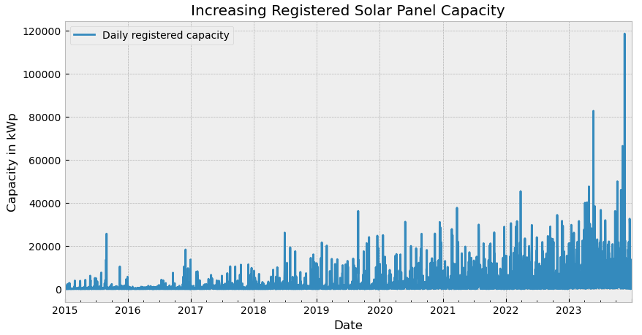
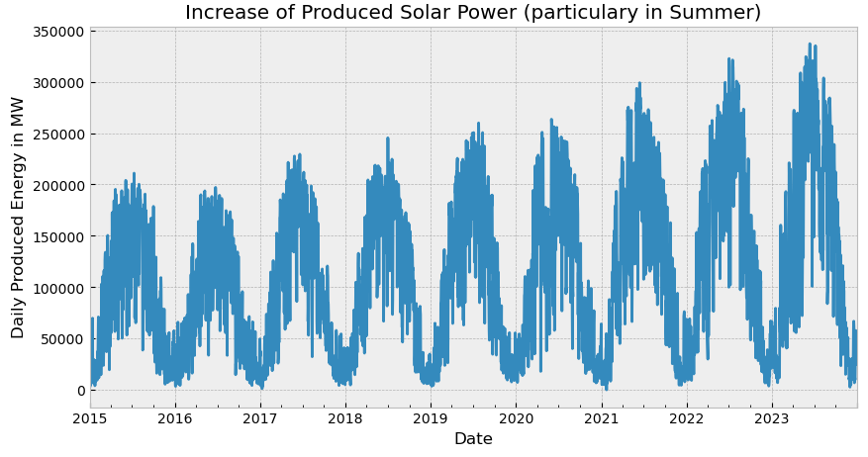
Explorative Data Analysis
Checking the raw data on plausibility and missing values
No issues for Marktstammdatenregister and produced energy (TenneT).

Slide 5
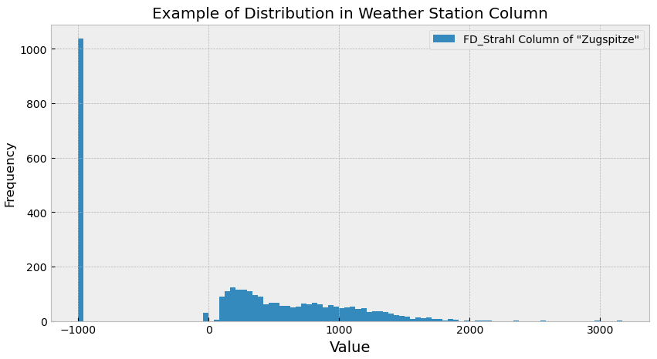
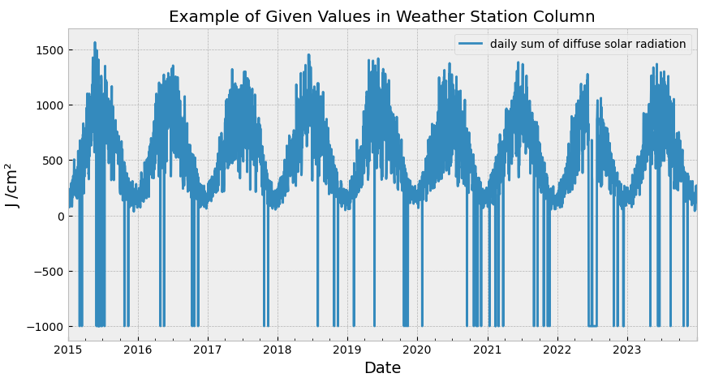
Explorative Data Analysis
Obviously missing data from DWD (value: -999), also rarely implausible values for solar radiation (value: 0 (J/cm²))

Slide 6
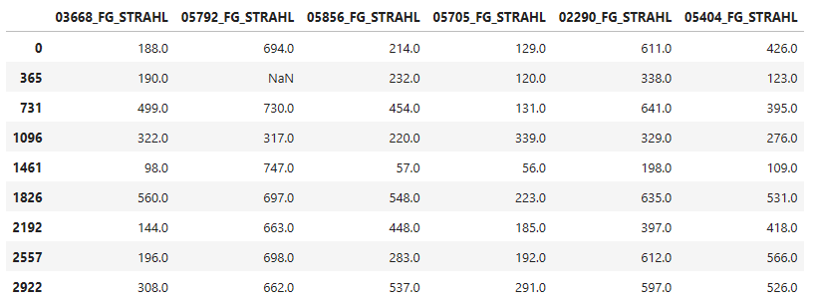
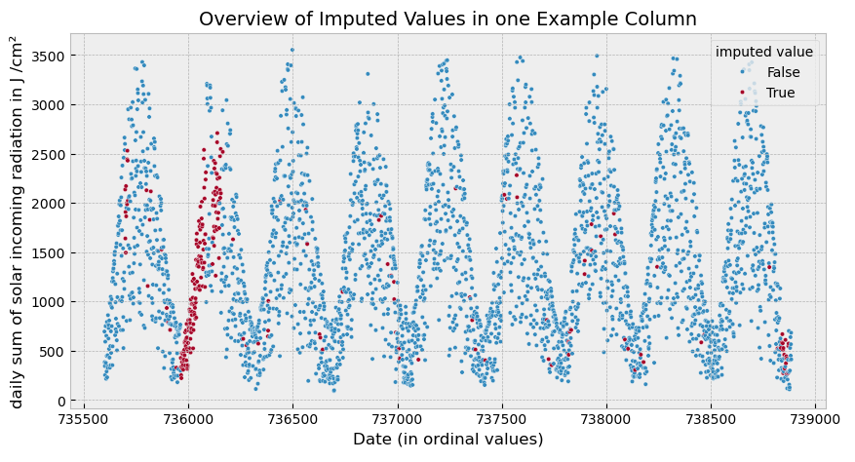
Data Imputation
Mean of median of column and median of row is used for imputation
Slope before imputation: 0.002
Slope after imputation: -0.004

Slide 7
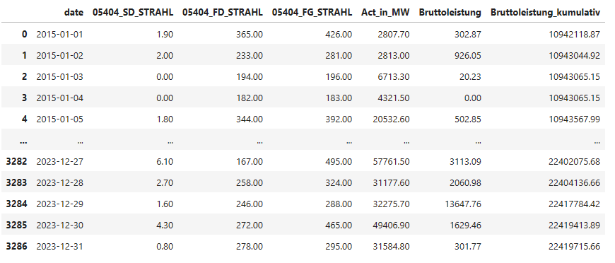
Excerpt of Dataframe

Slide 8
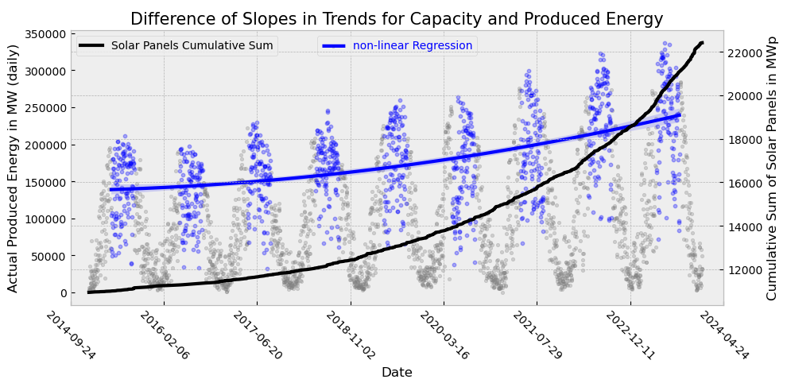
Trends within the data
Cumulative area of solar modules
Summer-Peaks of produced solar energy (May-August)
Presumed reason are technical details about measuring and usage of power

Slide 9
Regression Models(WO PCA/W PCA) :
Linear Regression
KNN Regression
Ridge Regression
Lasso Regression
Support Vector Machine Regression
Decision Tree Regression
Random Forest Regression
Modeling of Actual Solar Energy Power Generation with machine learning
Non-Regression Models :
Sequential Neural Network
GRU - Sequential Neural Network
LSTM - Sequential Neural Network

Slide 10
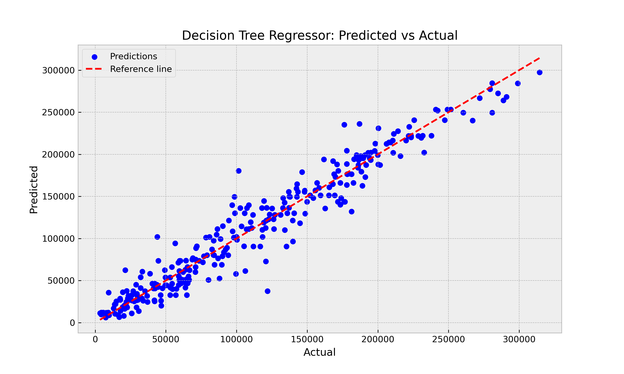

Slide 11
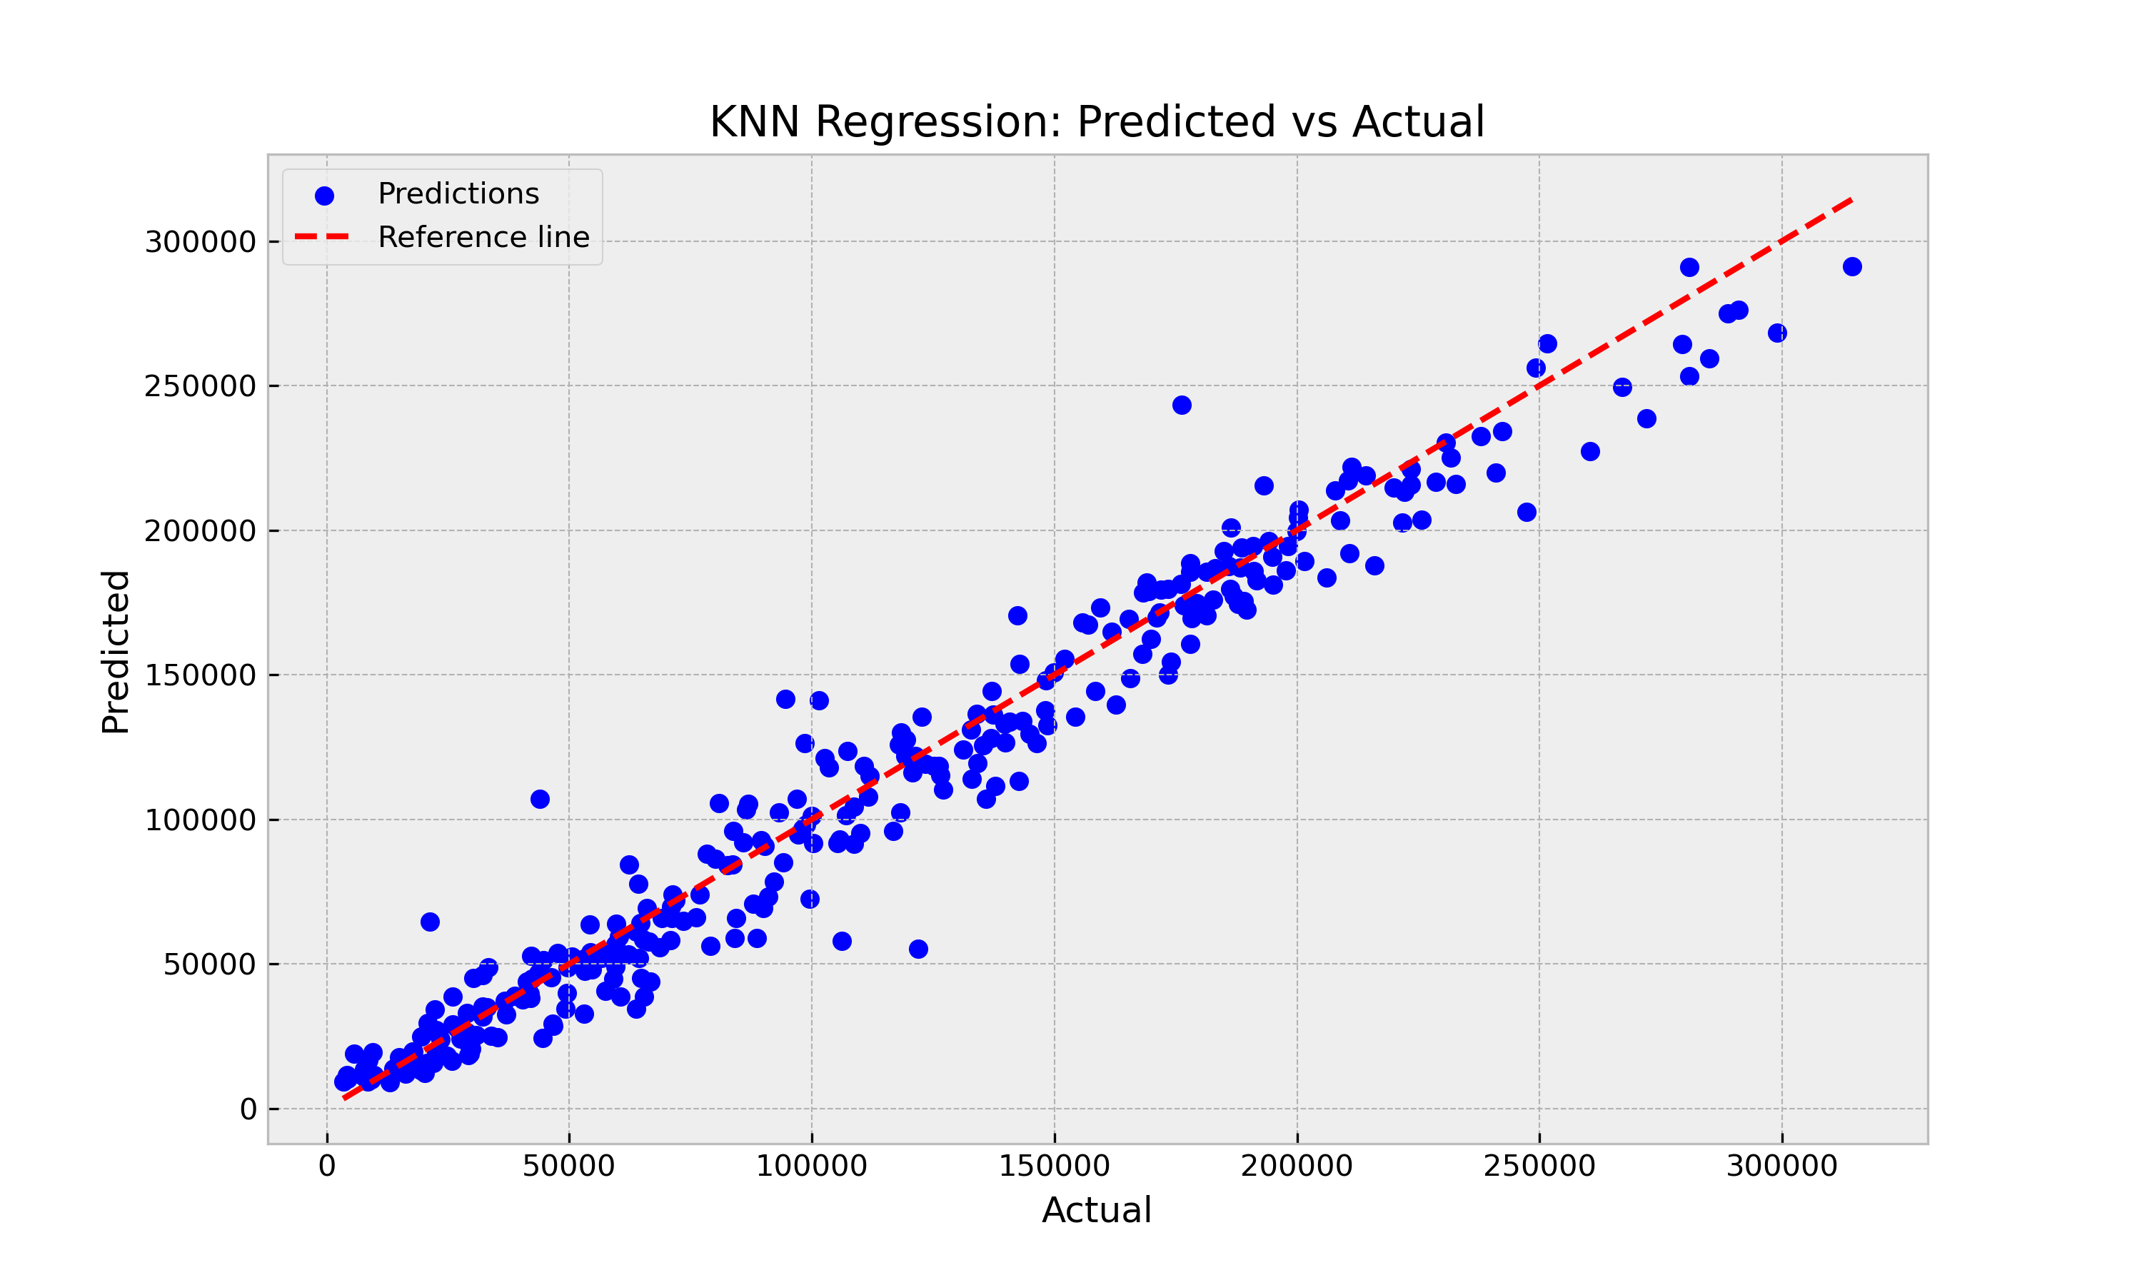
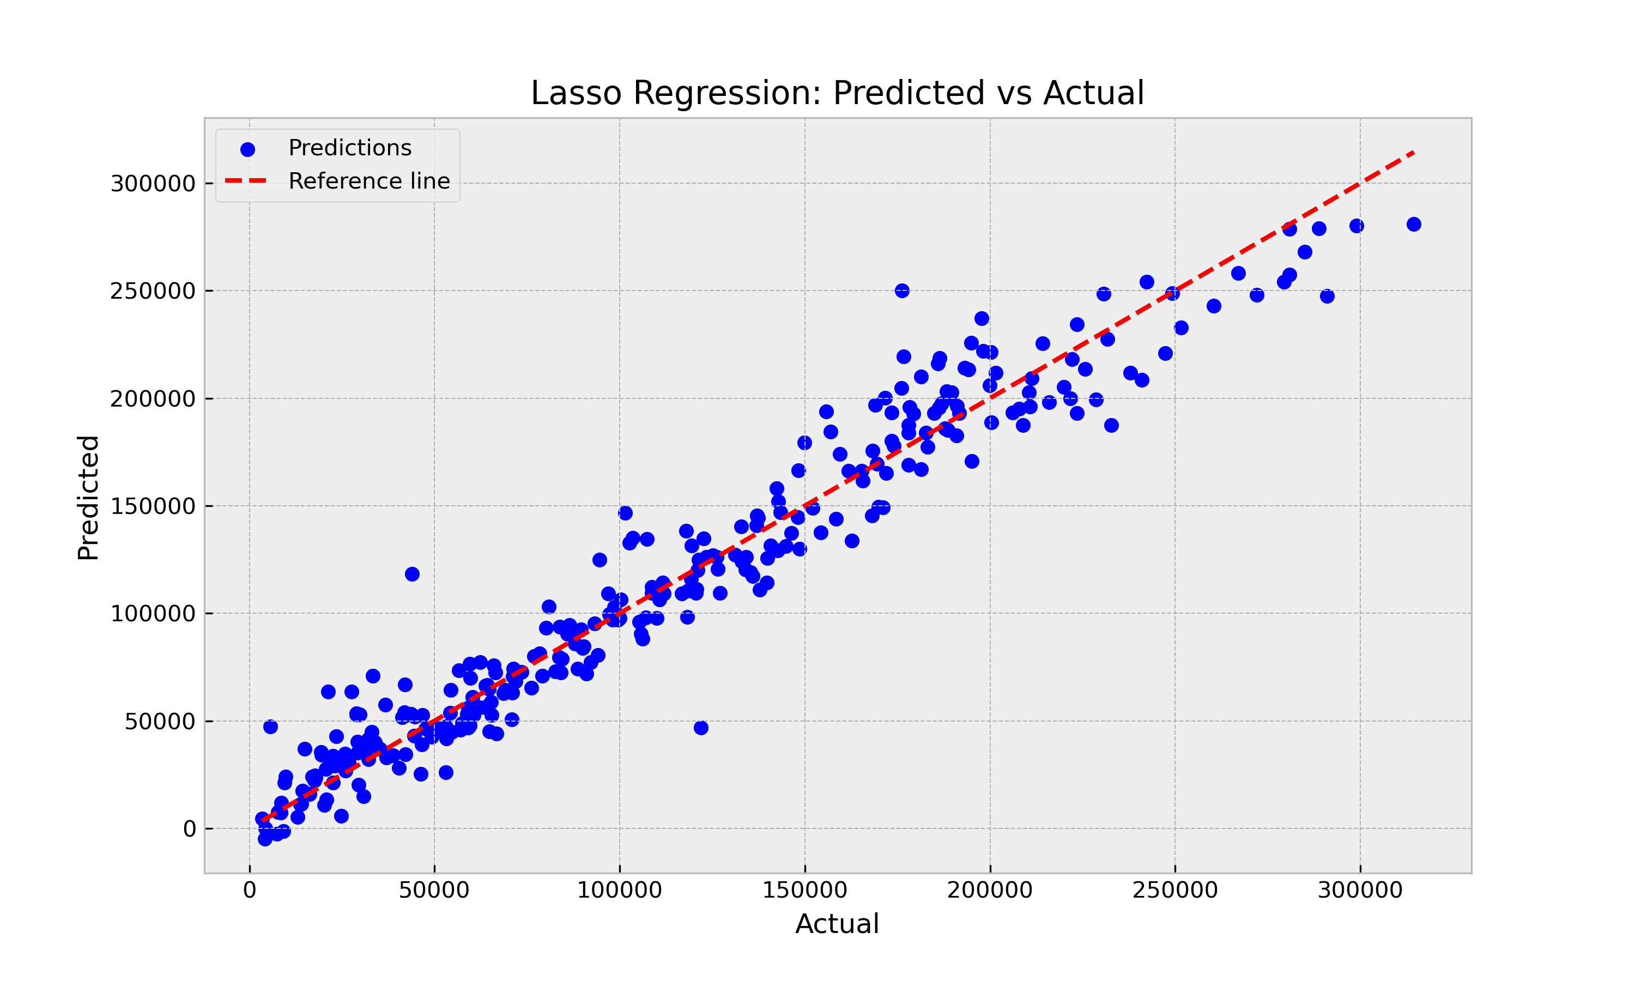
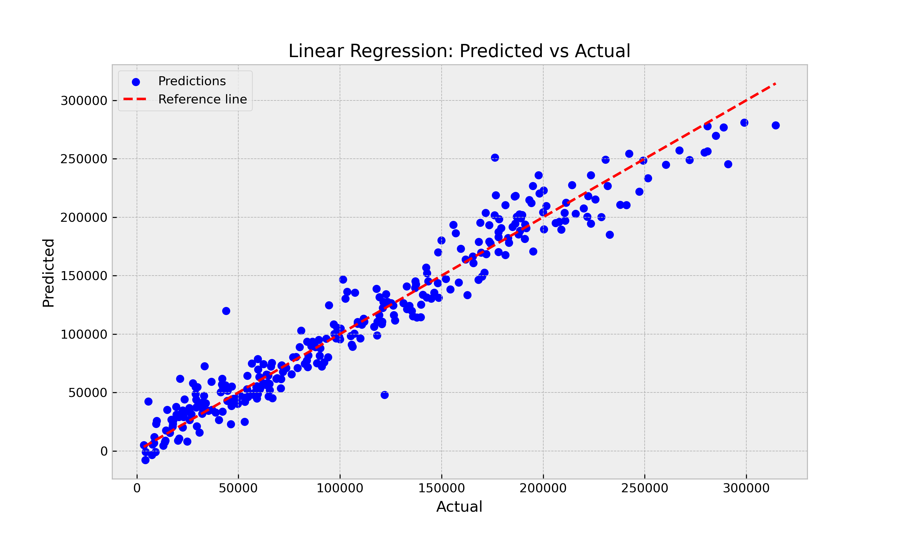
W/O PCA Step
Model | R2 score | MAE | MSE
KNN Regression | 0,959 | 10.781,40 | 224.022.258,54
Lasso Regression | 0,946 | 12.779,06 | 297.446.069,86
Linear Regression | 0,946 | 12.794,24 | 296.086.064,20
Ridge Regression | 0,945 | 12.770,61 | 299.820.066,05
DT Regression | 0,938 | 13.261,78 | 336.755.168,48
SVM Regression | 0,924 | 14.557,65 | 411.506.974,45

Slide 12
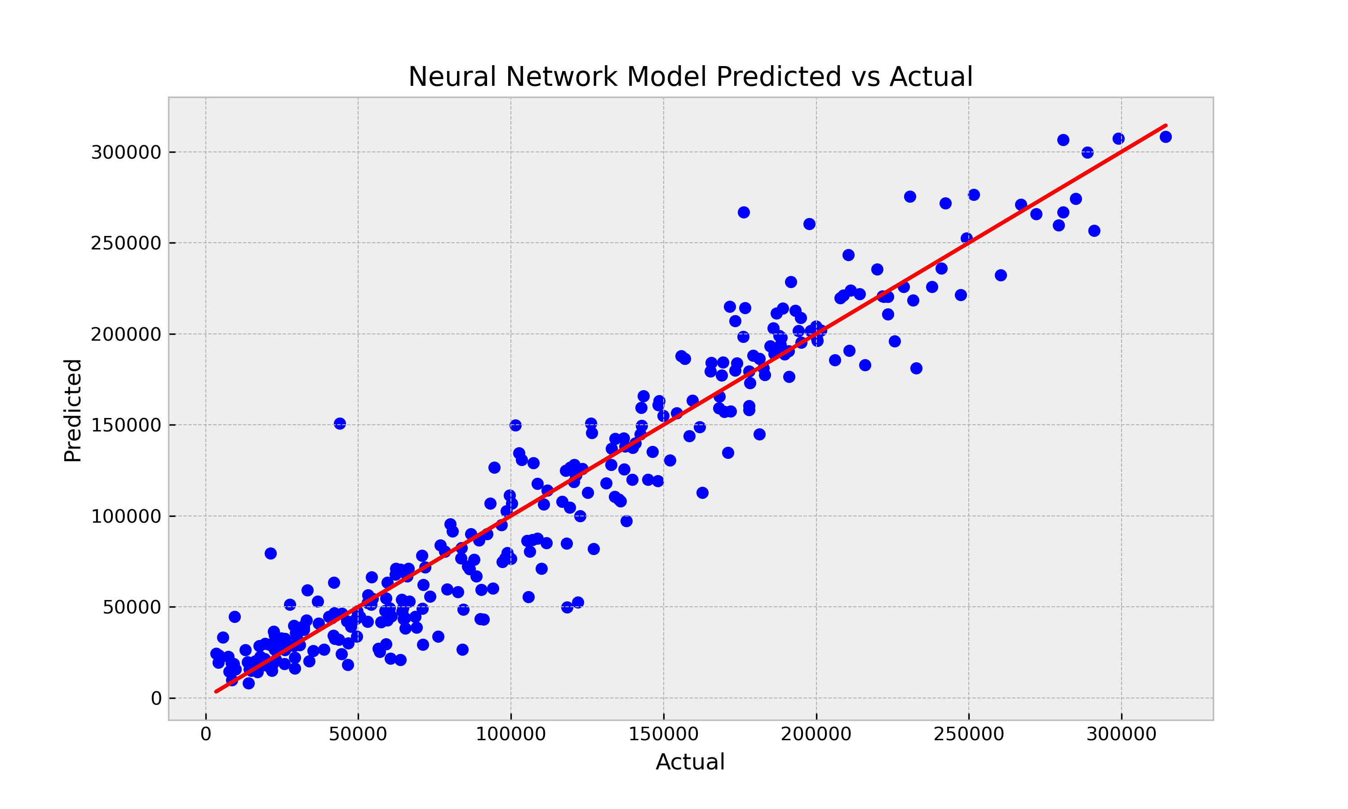
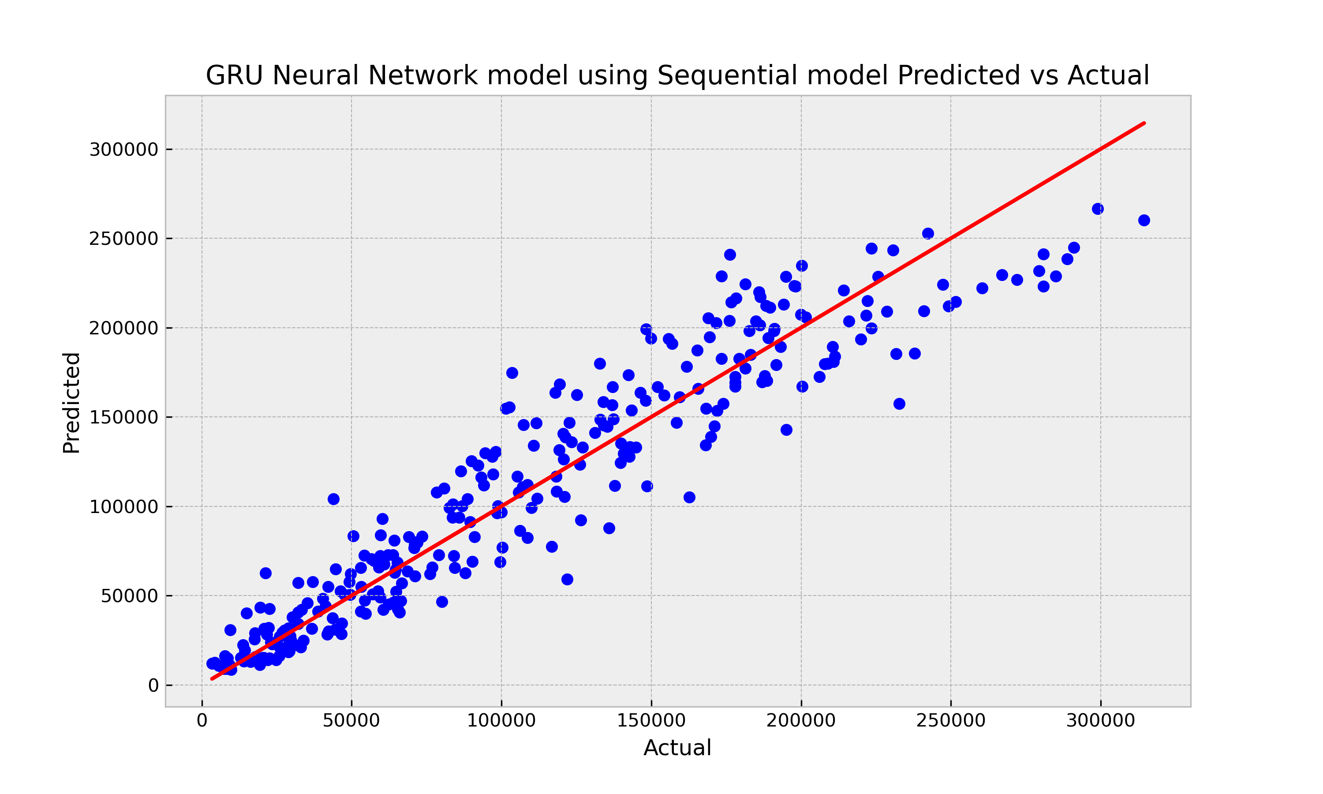
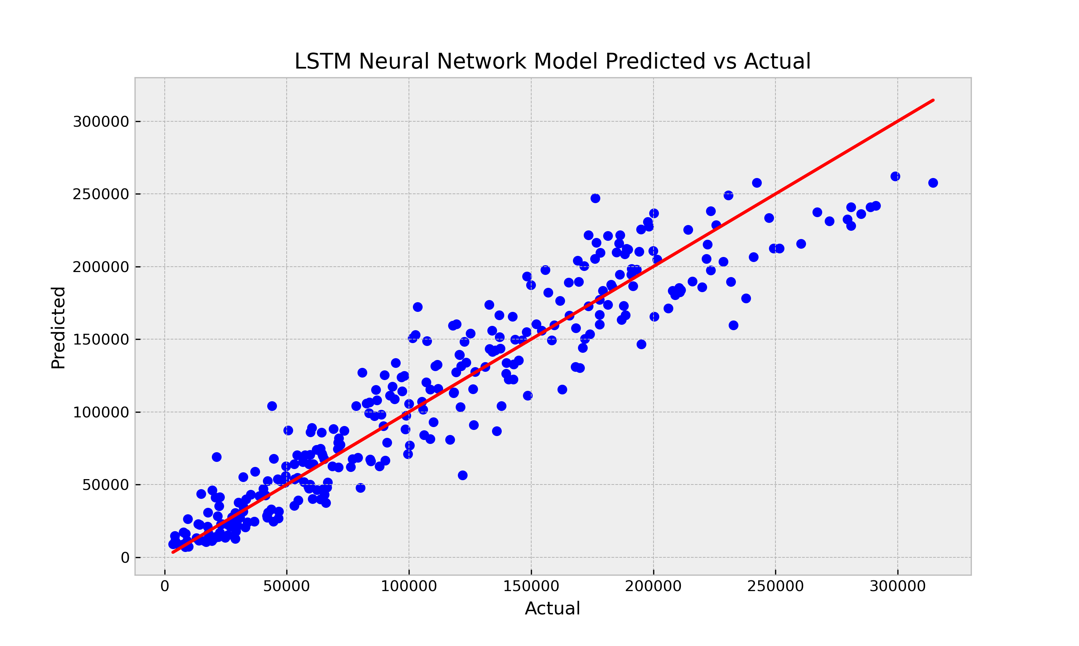
W/O PCA Step
Model | R2 score | MAE | MSE
NN - Sequential | 0,916 | 15.400,48 | 460.665.251,72
LSTM - NN | 0,889 | 19.092,38 | 605.512.615,47
GRU - NN | 0,889 | 19.389,78 | 607.048.866,33

Slide 13
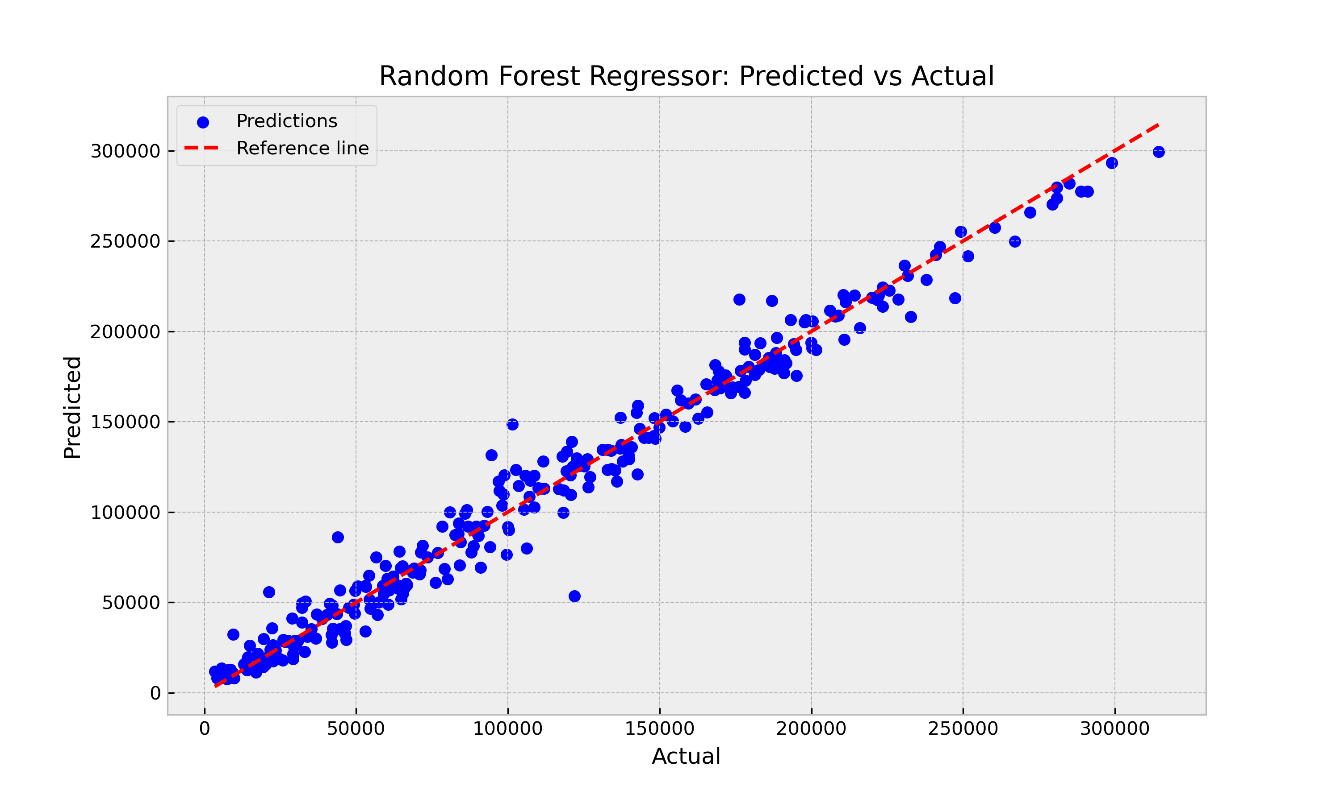
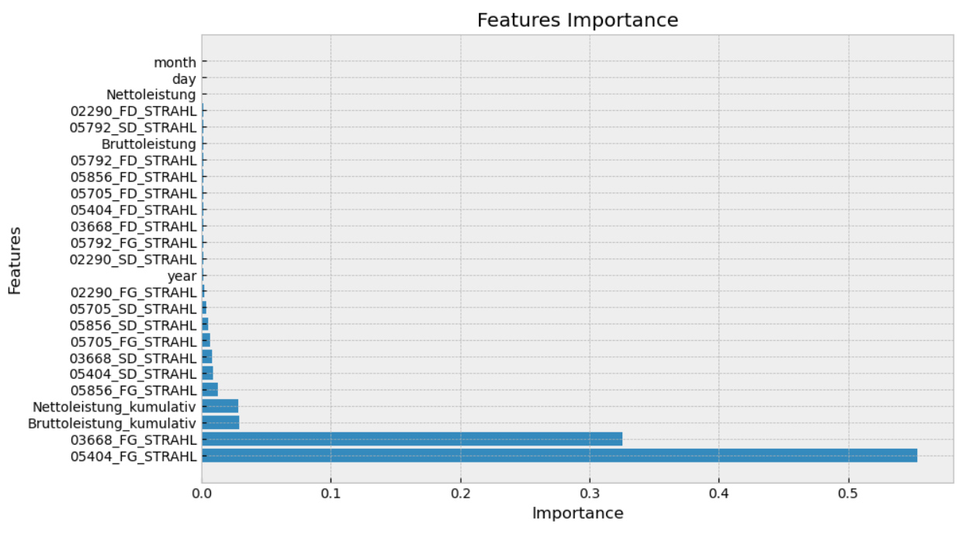
Apply Random Forest Regression Model on Train and Test DataFrame
W/O PCA Step
Model | R2 score | MAE | MSE
RF - Regression | 0,976 | 8.139,91 | 130.904.514,65
KNN-Regression | 0,959 | 10.781,40 | 224.022.258,54
NN -TensorFlow | 0,916 | 15.400,48 | 460.665.251,72
Notes:
13

Slide 14
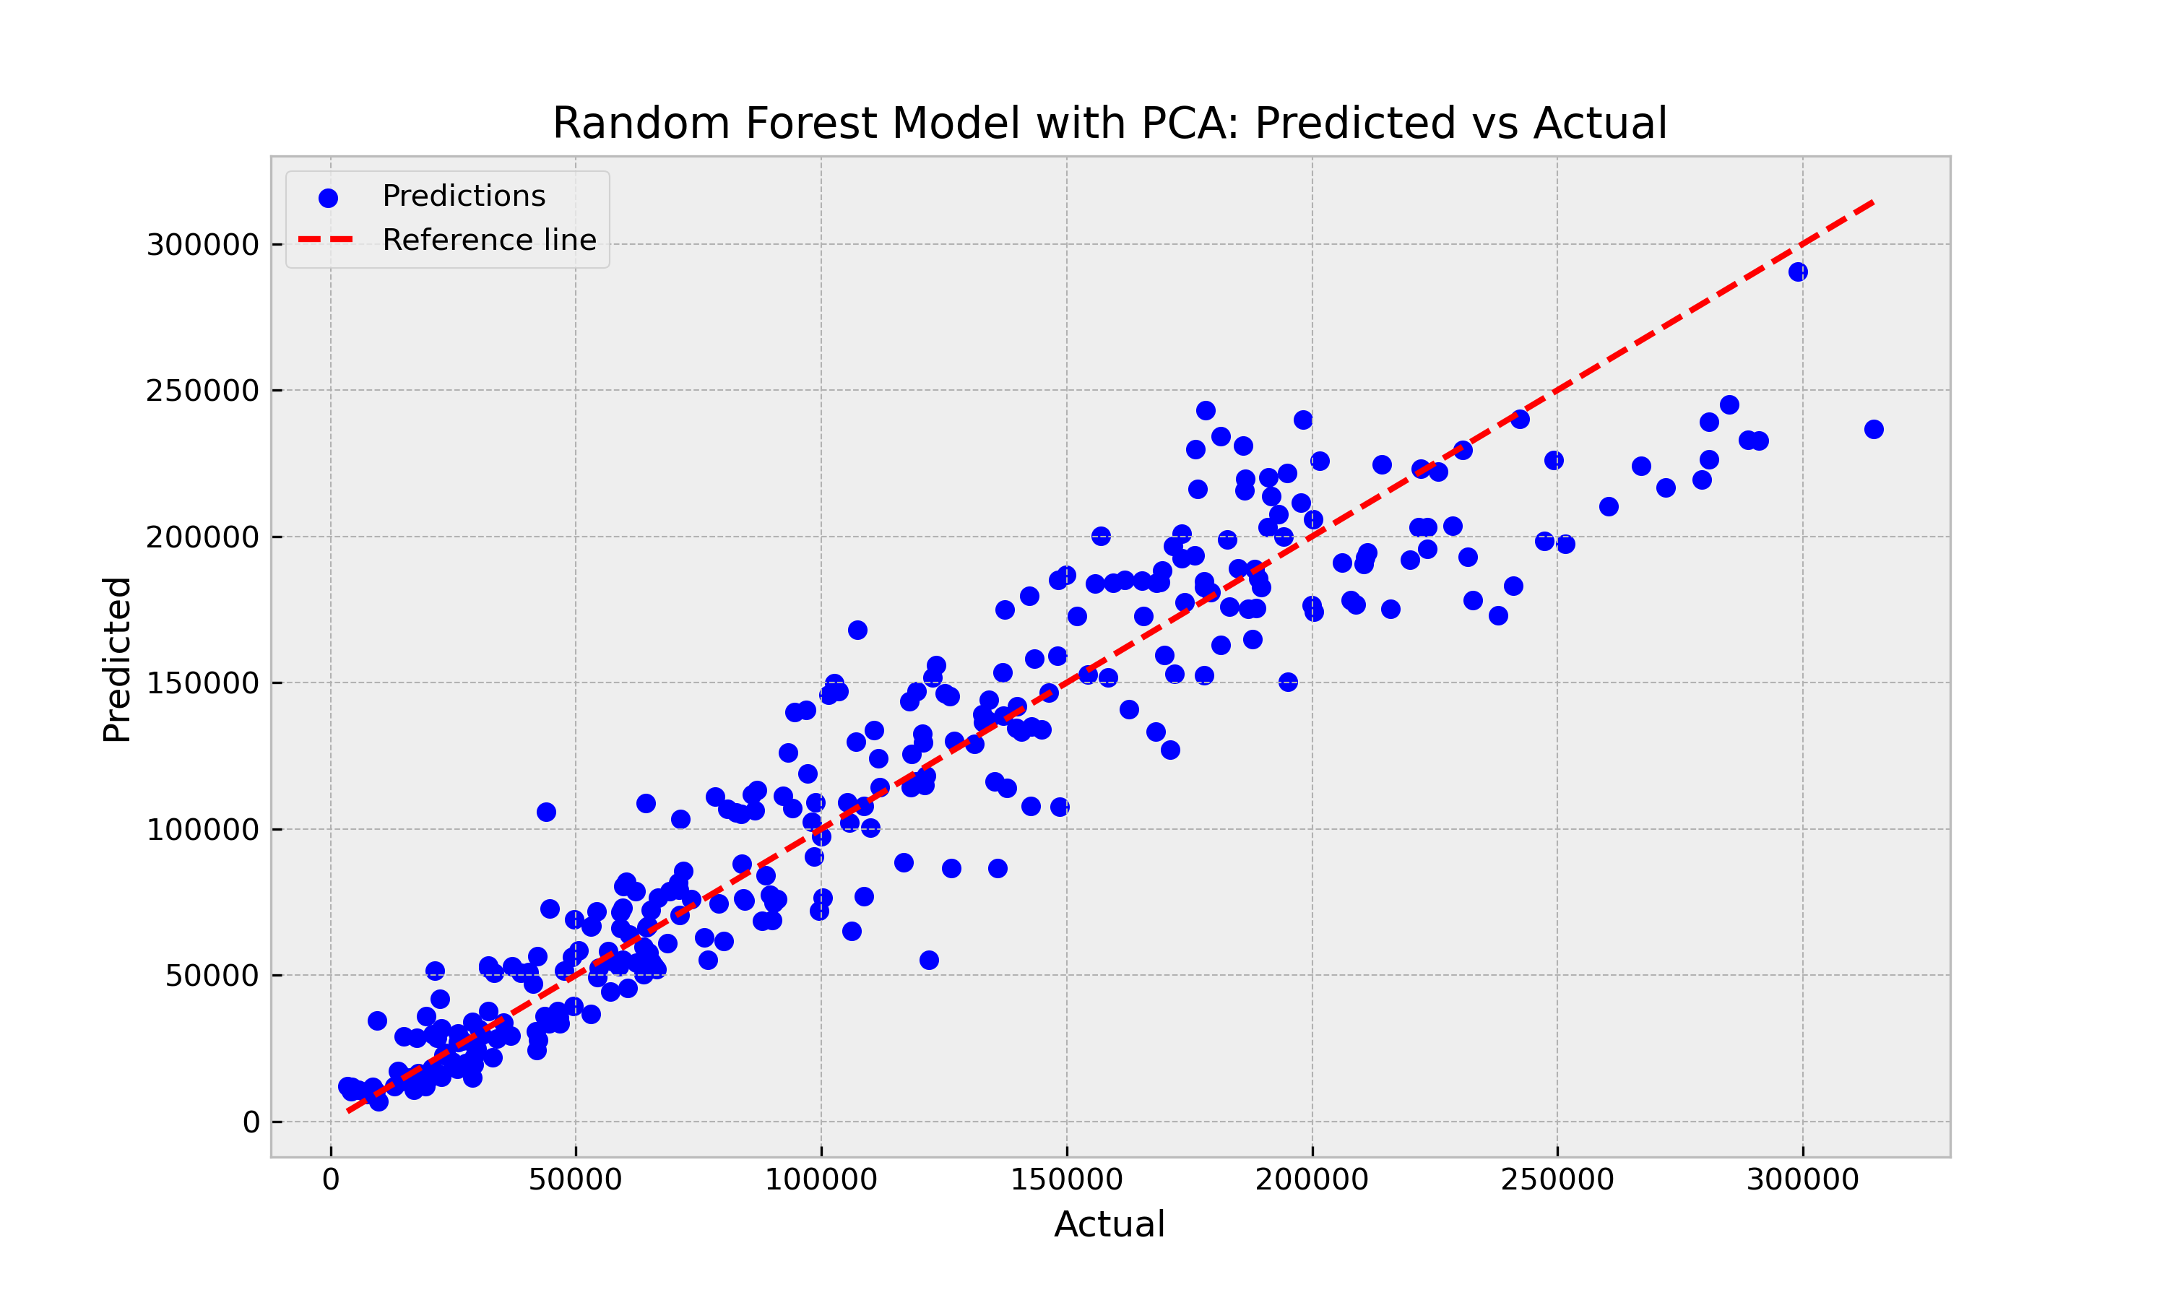
Apply PCA Step on FG Columns of Train and Test DataFrame
PCA Step | W/O PCA Step |  | W PCA Step
Model | R2 score | MAE | R2 score | MAE
RF -Regression | 0,976 | 8.139,91 | 0,896 | 17.766,60
KNN Regression | 0,959 | 10.781,40 | 0,879 | 19.546.23
Linear Regression | 0,946 | 12.794,24 | 0,876 | 19.034,50

Slide 15
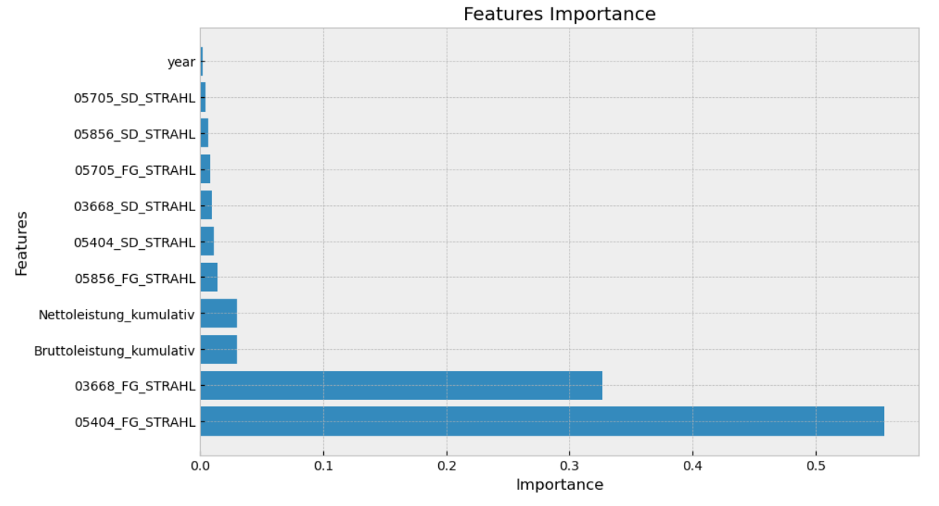
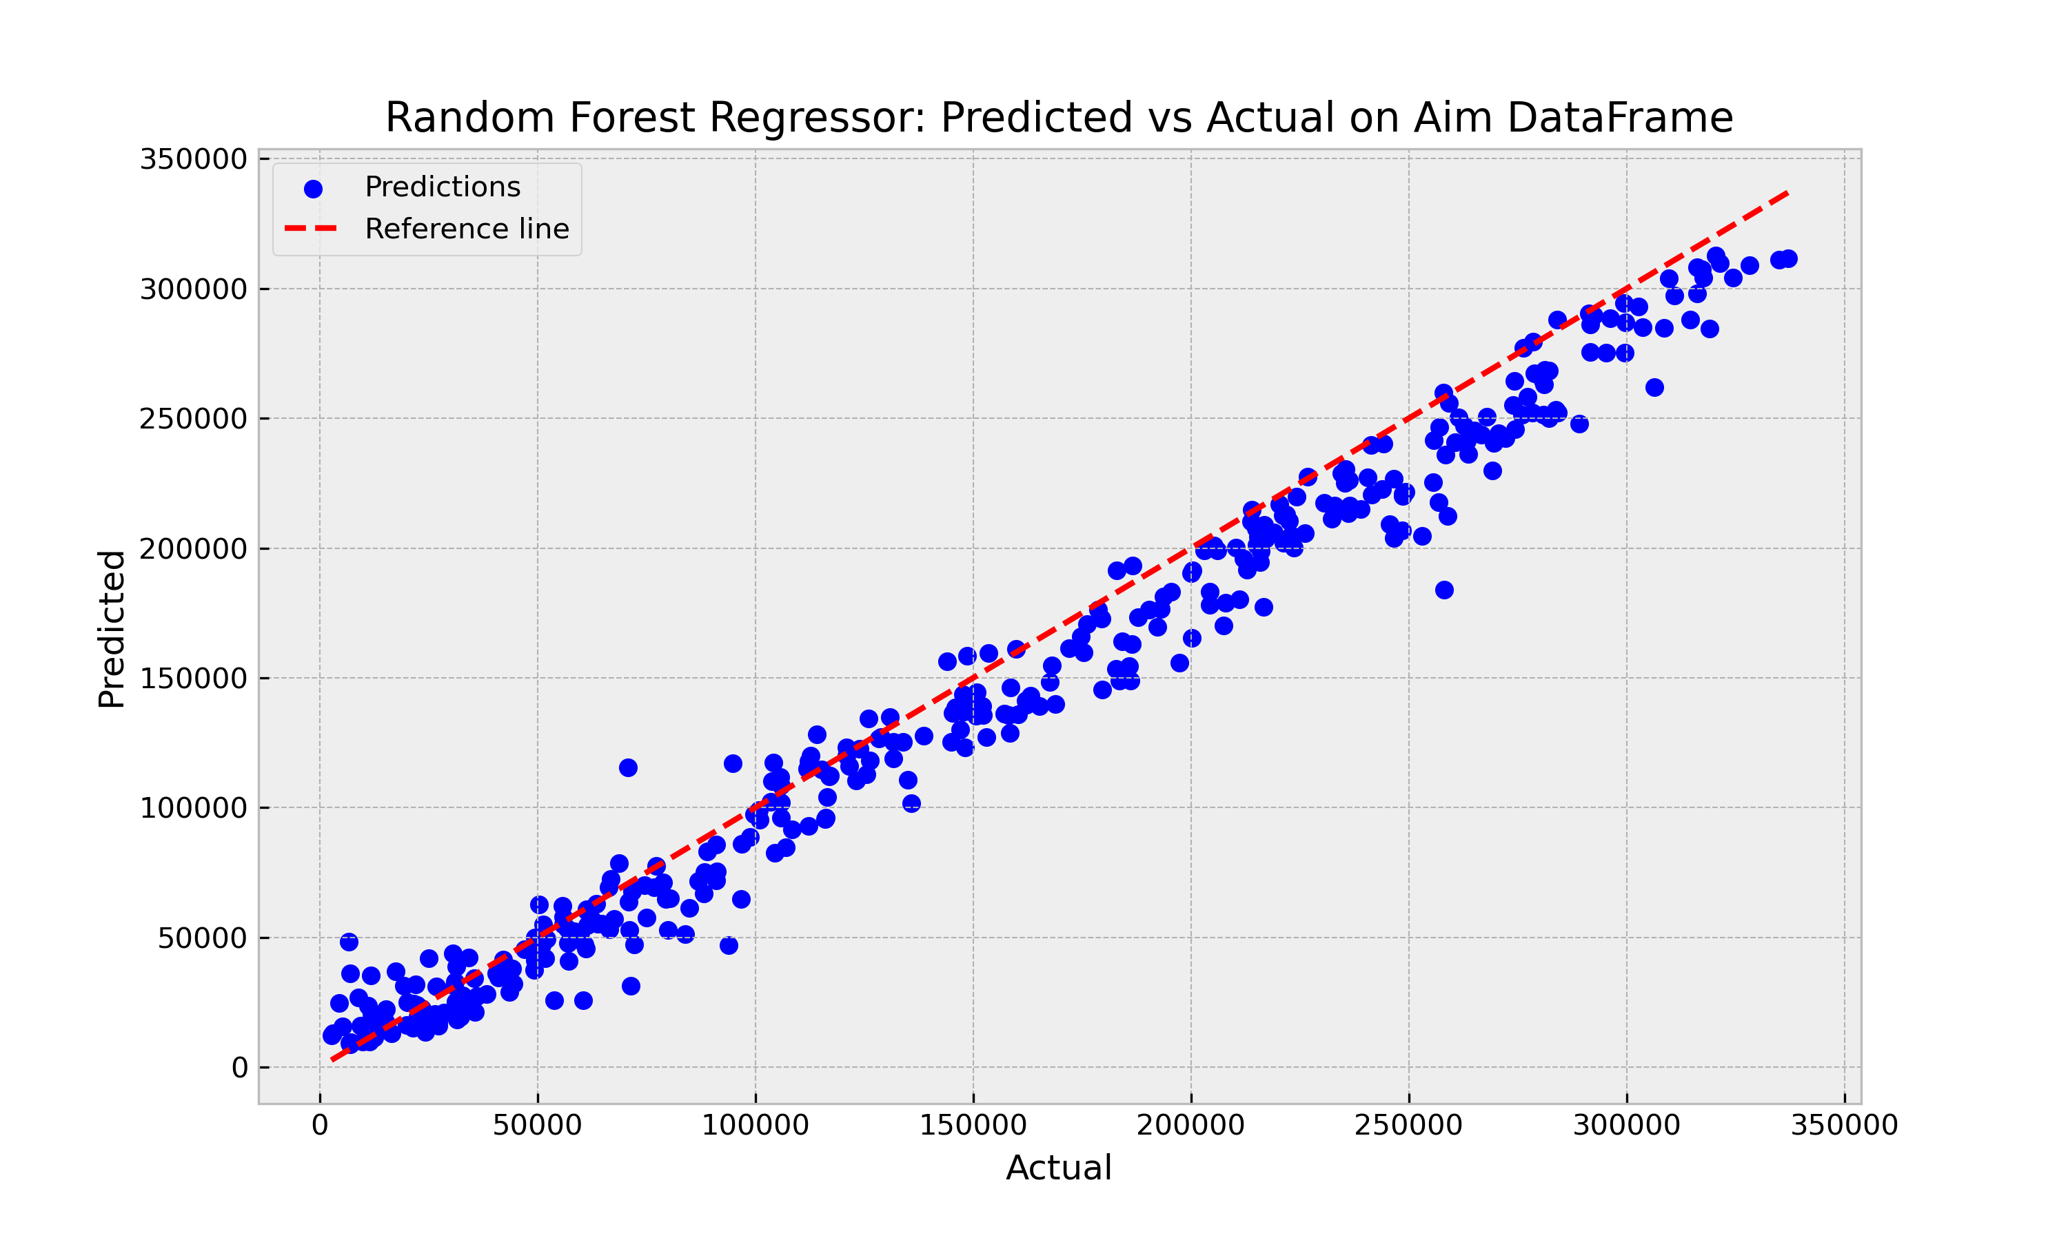
Prediction on Aimset (Year 2023)
Best Model
Random Forest Regressor
Features Selection : decrease features from 25 to 11
Metric values on Test DataFrame :
R2 score 0.975 and MAE = 8.218,07
Metric values on Aim DataFrame :
R2 score = 0.966 and MAE = 13.882,04

Slide 16
Stage 1 Identify the key features of the data and check for stationarity
Stage 2 Preselect models that are compatible with time series characteristics
Stage 3 Estimate model parameters
Stage 4 Select best model using an information criterion.
Stage 5 Perform visual and analytical diagnostics procedures
Stages of ARIMA Modeling

Slide 17
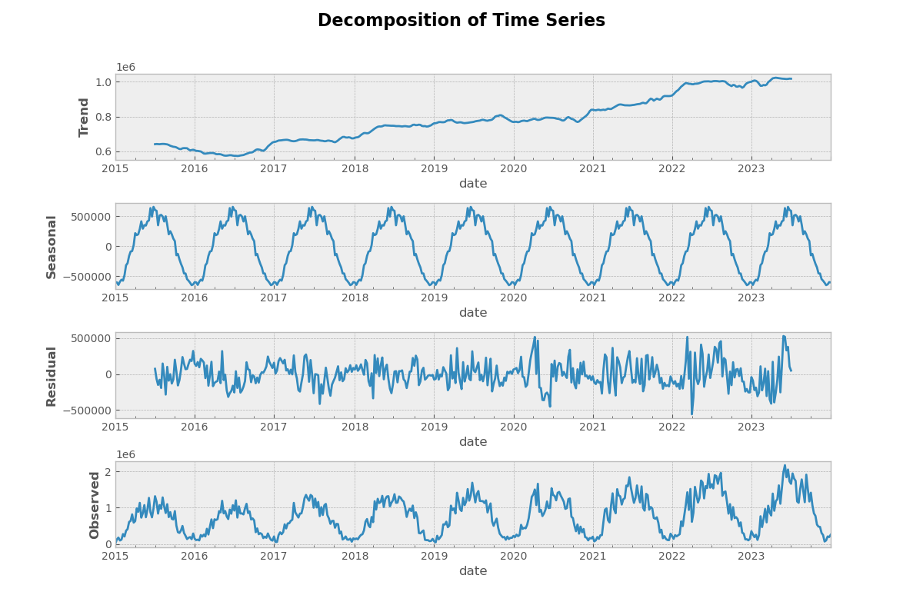
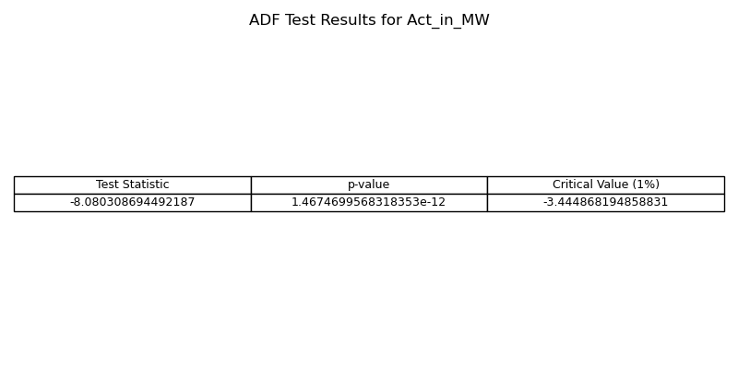
Check for stationarity of time series
Stationary Time Series: It maintains consistent mean, variance, and autocorrelations over time.
Time Series Analysis: Involves analyzing plots and decomposing features to identify trends, seasonal patterns, and noise.
Augmented Dickey-Fuller (ADF) Test: Essential for checking the stationarity of a time series.
It provides:
Test Statistic: Indicates the strength of rejection against non-stationarity.
p-value: Indicates the probability of observing the test statistic if non-stationarity is true.

Slide 18
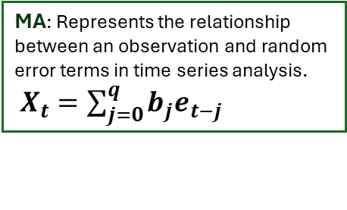
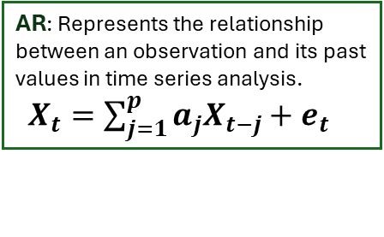
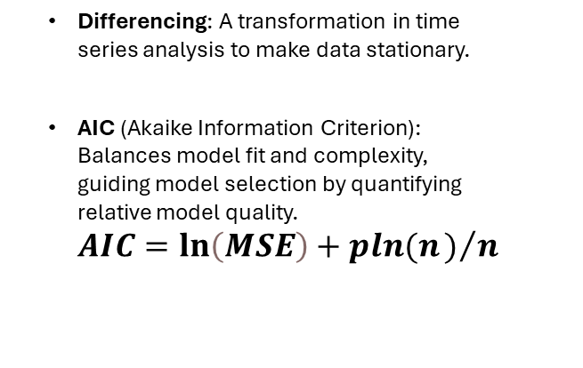
Key Concepts in ARIMA Time Series Analysis
ARIMA model: A forecasting method that combines AutoRegression (AR), differencing, and Moving Average (MA) components to analyze and predict time series data.
Differencing: A transformation in time series analysis to make data stationary.
AIC (Akaike Information Criterion): Balances model fit and complexity, guiding model selection by quantifying relative model quality. $AIC=\ln\left(MSE\right)+pln(n)/n$
AR: Represents the relationship between an observation and its past values in time series analysis. $X_{t}=\sum_{j=1}^{p}{a_{j}X_{t−j}+e_{t}}$
MA: Represents the relationship between an observation and random error terms in time series analysis. $X_{t}=\sum_{j=0}^{q}{b_{j}e_{t−j}}$
ACF plots are utilized to identify the Autoregression component, while PACF plots are employed to identify the Moving Average component.

Slide 19
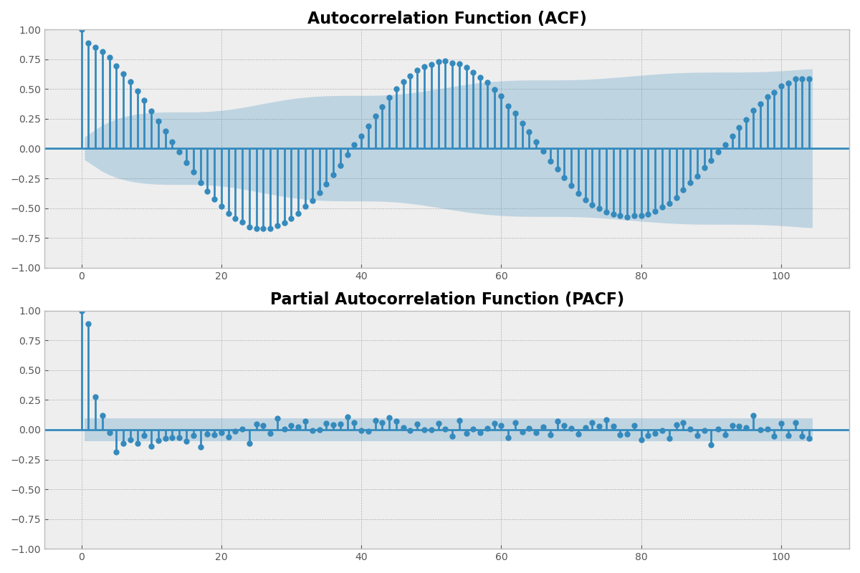
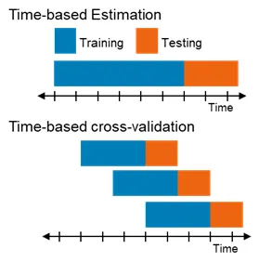
Estimate ARIMA(p,d,q) model Parameters
ACF plot and PACF plot: These plots provide insights into the autocorrelation and partial autocorrelation structures of the time series data.
Time series cross-validation sequentially splits the data based on time to preserve the temporal order of observations, enabling the determination of the best parameter.

Slide 20
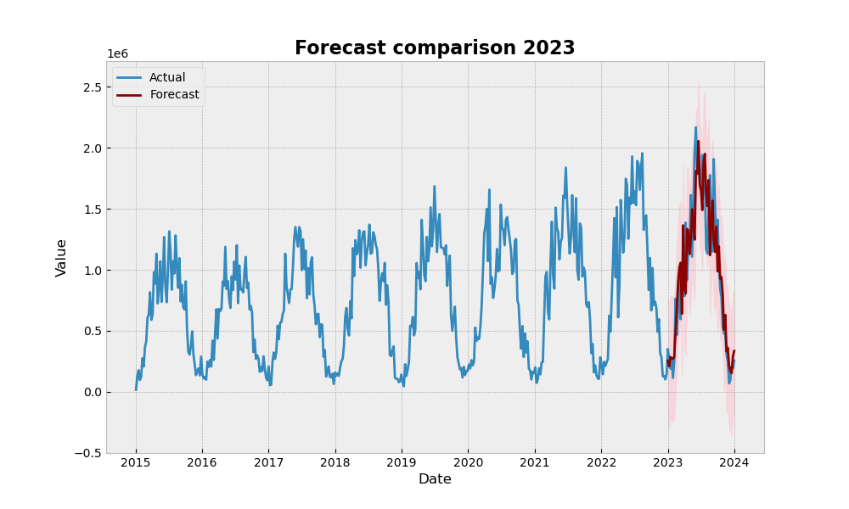
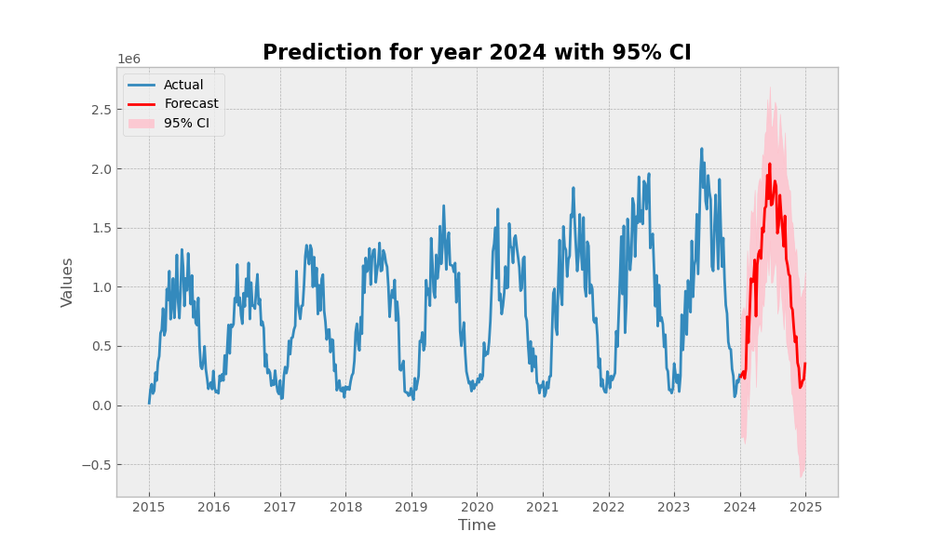
Forecasting with ARIMA Models
SARIMAX model with the following parameter estimates: Non-seasonal Component: (1, 1, 1), Seasonal Component: (1, 1, 0, 52)
we obtain the following insights:
AIC = 11480.522.
Diagnostic tests: (Ljung-Box = 0.02, JB = 34.87)
Ljung-Box test:
H0: There is no serial correlation in the residuals
Jarque-Bera test:
H0: The data is not normally distributed

Slide 21
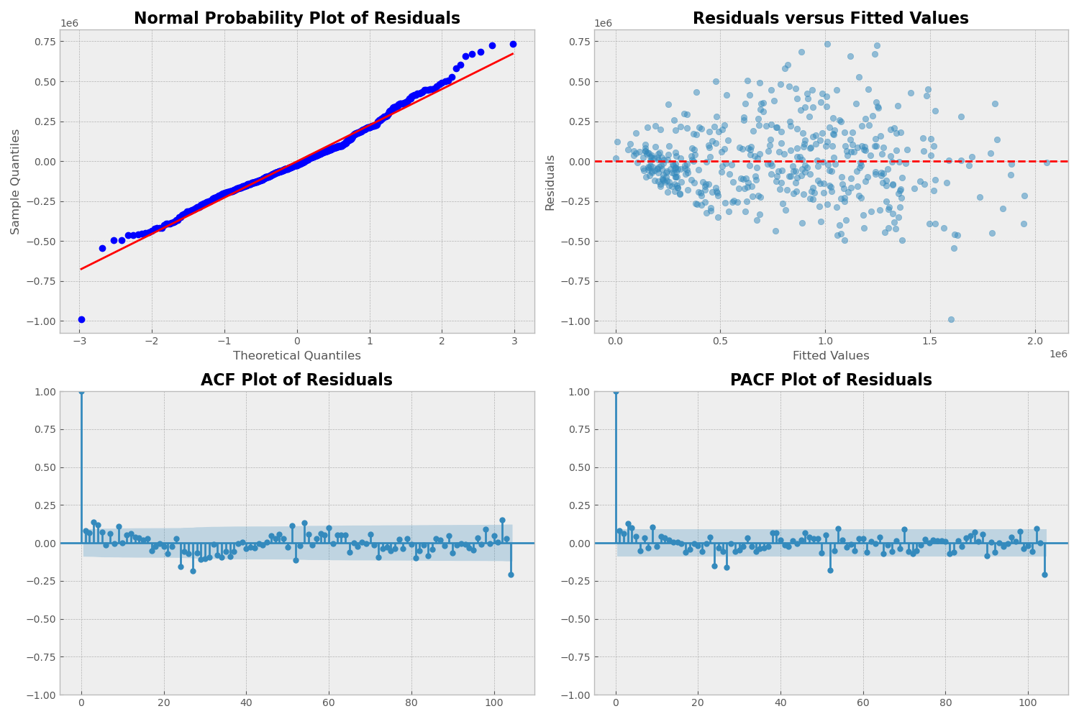
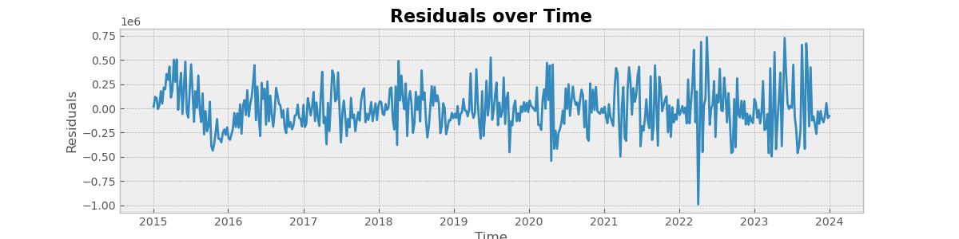
Model Diagnostics
What can go wrong?
The errors may not be normally distributed
The data ma contain outliers.
The time series may be non-stationary.
The erors may show changing variances over time.
The mean of the errors may be non-zero
How do we check for these problems:
Normal probability plot of residuals
Residuals versus fitted values
Residuals versus observation order
ACF/PACF plot of residuals

Slide 22
Use Cases
Time-Series Forecast | Daily Prediction via Regression
Customers minds are eased with positive outlook | Energy-related companies can plan the next days
Politicians and managers can see room for improvement | Virtual power plants needs to fill or empty storage strategically
Confidence interval shows realistic min/max peak-values | Own-usage could be improved (e.g. wait 2 days to charge your car)

Slide 23
Conclusion and Outlook
Forecast and prediction are both valid, usability is given, with very different use cases
Adding daily weather features including temperature, moisture content, wind speed, cloud content can be used for increased precision
Further scaling of this project could be different states, countries and type of renewable energy (wind)
Regression-approach for forecasting: using trends and means of given data

Slide 24

Thank you for your attention! Questions?

